Slide 1












Windows 11 Client + Linux Gateway
Firewall ➔ IPTables
IDS+IPS ➔ Snort
Demo
By
Rasheed Gomaa - ITLec

Slide 2
Agenda
Network Topology & Environment Setup
How to configure Static IP for both Windows & Linux?
How to setup a Linux as a gateway to windows?
Iptables as a Firewall
Snort as IDS & IPS
Setup rules in snort
Https is more secure than Http

Slide 3
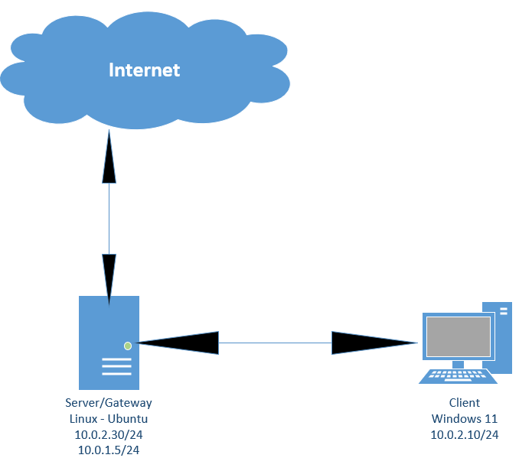
Network Topology

Slide 4
Environment Setup
Oracle VirtualBox
Virtual NAT Networking
Windows 11
Linux-Ubuntu
Install snort
For Packet sniffing:-
Enable promisc
ip link set enp0s3 promisc on

Slide 5
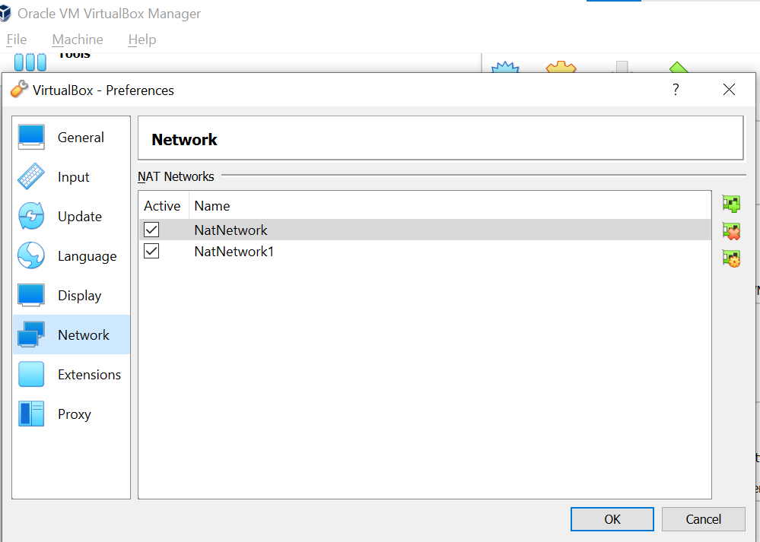
Network Setup
Windows 11 – one interface
10.0.2.10/24
Linux – Two interfaces
10.0.2.30/24
10.0.1.9/24

Slide 6
Static IP
Windows
Linux

Slide 7
Test connection tcpdump
tcpdump -D
tcpdump -i [interfaceName/any] -c [NumberOfCapturedPackets/5] [-n display clear text ip & port]

Slide 8
Setup Gateway
Enable forwarding:-
echo "1" > /proc/sys/net/ipv4/ip_forward

Slide 9
Configure Iptables to provide internet access to the windows 11 client:-
Clear Iptables:-
sudo iptables –F
sudo iptables -X
iptable default policy "blacklist“
sudo iptables -i enp0s3 -P INPUT ACCEPT # option -P means default policy
sudo iptables -i enp0s3 -P OUTPUT ACCEPT
sudo iptables -i enp0s3 -P FORWARD ACCEPT
Configure POSTROUTING:-
iptables -t nat -A POSTROUTING -s [IPofExternalClient] -i [NameOfInternalServerInterface] -j MASQUERADE
iptables -A FORWARD -i enp0s3 -d 10.0.2.10 -j ACCEPT

Slide 10

Snort – IDS & IPS
Configuration File:-
sudo vi /etc/snort/snort.conf
Rules File:-
sudo vi /etc/snort/rules/local.rules
Rules:-
alert tcp any any -> any any (content: "youtube"; msg:"Alert youtube by ITLec"; sid:4444; rev:1)
Test Config:-
snort -i enpoOs3 -c /etc/snort/snort.conf -A console –T
Run Snort:-
snort -i enpoOs3 -c /etc/snort/snort.conf -A console

Slide 11
Https is more secure than http !!! Thanks you !!!

